Slide 1

JAVA
Training
Any use, copying or distribution without written permission from UnitedHealth Group is prohibited.

Slide 2
Agenda
What is Java
Data Types
Variables
Arrays
Operators
Statements, Expression, Blocks
Any use, copying or distribution without written permission from UnitedHealth Group is prohibited.

Slide 3
Java
Java is platform independent.
  With application programs written in Java, you can change/upgrade OS and applications independently.
Java is a Object-oriented, strongly typed language.
  Strongly typed languages specify one or more restrictions on how operations involving values having different data types can be intermixed.
Any use, copying or distribution without written permission from UnitedHealth Group is prohibited.

Slide 4
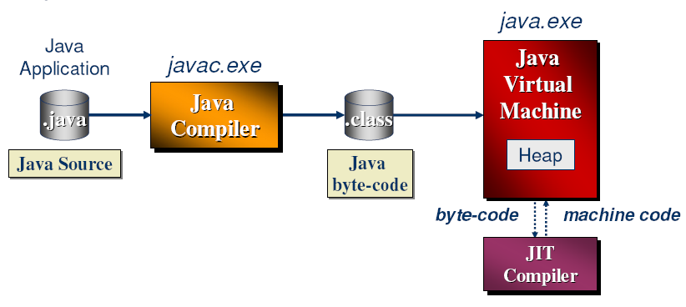
JVM
A virtual machine (VM) is an abstract computer architecture
Software on top of a real hardware
Can run the same application on different machines where the VM is available
Any use, copying or distribution without written permission from UnitedHealth Group is prohibited.
Notes:
Java source code is compiled to byte-codes whose target architecture is the Java Virtual Machine (JVM)
Just-in-time (JIT) compiler provides compilation of byte-code to machine code

Slide 5
Java Advantage
  Write less code
  Write better code
  Develop program faster
  Avoid platform dependencies 100% pure java
  Write once, run anywhere
  Distribute software easily
  Get started quickly
  Write secure code
  Java Code ------------------→ Byte Code ---------------------→Executable
  (.java) javac (.class) java / jre
Any use, copying or distribution without written permission from UnitedHealth Group is prohibited.

Slide 6
Data Types
Primitive Data Types
byte 8-bit -2⁷ to 2⁷-1
short 16-bit -2¹⁵ to 2¹⁵-1
int 32-bit -2³¹ to 2³¹-1
long 64-bit -2⁶³ to 2⁶³-1
float 32-bit
double 64-bit
boolean true or false
char 16-bits All 216 characters in Unicode character set – includes letters, digits, special characters
    Unicode is a encoding standard (like ASCII) that provides a unique number for every character
Any use, copying or distribution without written permission from UnitedHealth Group is prohibited.

Slide 7
Variables
A symbol or name that stands for a value.
  For example, in the expression x+y , x and y are variables.
Naming
  Variable names are case-sensitive
  A variable's name can be any legal identifier — a sequence of Unicode letters and digits, beginning with a letter, the dollar sign "$", or the underscore character "_“.
    String 1EmpName is invalid declaration.
  The convention, is to always begin your variable names with a letter, not "$" or "_“.
    prefer String empName over String _EmpName
  You may find some situations where auto-generated names will contain the dollar sign, but your variable names should always avoid using it.
  White space is not permitted
Any use, copying or distribution without written permission from UnitedHealth Group is prohibited.

Slide 8
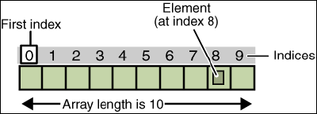
Arrays
An array is a container object that holds a fixed number of values of a single type.
The length of an array is established when the array is created
After creation, its length is fixed
Any use, copying or distribution without written permission from UnitedHealth Group is prohibited.

Slide 9
Arrays
Create and Initialize an array :
int[] anArray;
anArray = new int[10];
OR
int[] anArray = new int[10];
anArray[0] = 100;
Alternatively, you can use the shortcut syntax to create and initialize an array
int[] anArray = {100, 200, 300, 400, 500, 600, 700,800, 900, 1000};
Here the length of the array is determined by the number of values provided between { and }
The System class has an arraycopy method that you can use to efficiently copy data from one array into another:
public static void arraycopy(Object src,int srcPos, Object dest, int destPos,int length)
Any use, copying or distribution without written permission from UnitedHealth Group is prohibited.

Slide 10
Array Sample
class ArrayCopyDemo {
public static void main(String[] args) {
char[] copyFrom = { 'd', 'e', 'c', 'a', 'f', 'f','e', 'i', 'n', 'a', 't', 'e', 'd' };
char[] copyTo = new char[7];
System.arraycopy(copyFrom, 2, copyTo, 0, 7);
System.out.println(new String(copyTo));
}
}
Any use, copying or distribution without written permission from UnitedHealth Group is prohibited.

Slide 11
Lab 1.1
Write a “Hello World” program
Any use, copying or distribution without written permission from UnitedHealth Group is prohibited.

Slide 12
Operators
Arithmetic : *, -, +, /, %
Assignment: =
Compound Assignment Arithmetic : *=, -=,+=, /=, %=
String Concatenation: +
Increment/ Decrement : ++, --
Relational : <, >, <=, >=, ==, !=
Logical : &&, ||
Conditional : ? :
Others : new, [], instanceof
Any use, copying or distribution without written permission from UnitedHealth Group is prohibited.

Slide 13
Statements and Blocks
A Java statement is the smallest unit that is a complete instruction.
Statements must end with a semi-colon.
Statements generally contain expressions (expressions have a value)
Statement Blocks
In Java, any sequence of statements can be grouped together to function as a single statement by enclosing the sequence in braces. These groupings are called statement blocks. A statement block may also include variable declarations.
Statement blocks are used to define methods and to allow multiple statements in the control structures
Any use, copying or distribution without written permission from UnitedHealth Group is prohibited.

Slide 14
Statements
Expression statements
  Assignment statements
  Any use of ++ or --
  Method invocations
  Object creation expressions
Control statements
  Conditional Execution and Selection (if, if-else, switch)
  Repetition (for, while, do-while)
  Special Control Statements (break, continue, return)
Any use, copying or distribution without written permission from UnitedHealth Group is prohibited.

Slide 15
Control Statements
Conditional Execution And Selection
  If Statements - conditional execution of a single statement
  If-Else Statements - conditional selection among two statements
  Switch Statements - conditional selection among several statements
Repetition
  While Loops - pretest loops
  For Loops - pretest loops
  Do-While Loops - post test loops
Special Control Statements
  Return Statements - return values from and terminate methods
  Continue Statements - skip the remaining statements in an iteration of a loop
  Break Statements - exit a loop or switch statement
Any use, copying or distribution without written permission from UnitedHealth Group is prohibited.

Slide 16
Conditional Execution and Selection
If Statements
  The if statement has the following form.
  if (boolean-expression) {
      then-clause
  }
Here,
boolean-expression is an expression that can be true or false.
then-clause is a sequence of statements. If there is only one statement in the sequence then the surrounding braces may be omitted. The then-clause statements are executed only if the boolean-expression is true.
Any use, copying or distribution without written permission from UnitedHealth Group is prohibited.

Slide 17
Conditional Execution and Selection
If-Else Statements
  The if-else statement has the following form.
  if (boolean-expression) {
      then-clause (this is another statement)
} else {
      else-clause
  }
Here,
boolean-expression is an expression that can be true or false.
then-clause and else-clause are sequences of statements. If there is only one statement in a sequence then the surrounding braces may be omitted. The then-clause statements are executed only if the boolean-expression is true. The else-clause statements are executed if the boolean-expression is false.
Any use, copying or distribution without written permission from UnitedHealth Group is prohibited.

Slide 18
Conditional Execution and Selection
Switch Statements
The switch statement allows execution of different statements depending on the value of an expression. It has the following form.
  switch (control-expression) {
  case constant-expression-1:
      statements-1
  .
  .
  .
  case constant-expression-n:
      statements-n
  default:
      default-statements
  }
Any use, copying or distribution without written permission from UnitedHealth Group is prohibited.

Slide 19
Class
  template or blue print, In Java, everything is in classes
  Unit of programming/Unit of execution
  must be only one public class per file
  file name must be the same as the name of that public class, but with a .java extension
  Types of Class:-
  Concrete Class Abstract Class
    Can be instantiated Cannot be instantiated
    Only non abstract methods May or may not have abstract method
    May have concrete methods
  Components of Class:-
  variables
  methods
Any use, copying or distribution without written permission from UnitedHealth Group is prohibited.

Slide 20
Class
class Car
{
int noOfTyres = 4;
public void move()
{
}
}
  Car is a class having one instance variable and one instance method.
It encapsulate data and method and protect data.
Any use, copying or distribution without written permission from UnitedHealth Group is prohibited.

Slide 21
Object
  is an instance of a class / real entity
  can be instantiated and manipulated
  discrete independent unit which encapsulate some functionality
  it’s characteristics are defined by the class that was used to create the object.
  Class Test {
  public static void main ( String args [] )
  {
  Car car = new Car(); // create Car class object
  // allocates memory to Car object
  }
  }
Any use, copying or distribution without written permission from UnitedHealth Group is prohibited.

Slide 22
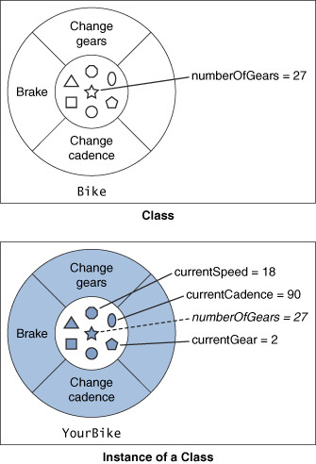
Class & Object
Any use, copying or distribution without written permission from UnitedHealth Group is prohibited.

Slide 23
Member Variables
Member variable declaration
  Declaration is the same as common variables
  Any where in a class, outside all methods
Used within the class
  Can be used/referenced anywhere directly.
  Class Course {
    Private int courseId;
    Private String courseName;
    }
Any use, copying or distribution without written permission from UnitedHealth Group is prohibited.

Slide 24
Defining methods
With a return value (type)
  Public String getCourseInfo() {
  String info=prefix+number+" "+title;
  return info; //return is required
  }
Without a return value (type)
  Public void printCourseInfo() {
  System.out.println(getCourseInfo());
  System.out.println(“# of Sections: "+numberOfSections);
  }
With Parameters
  Public void addSection(int number) {
  numberOfSections=numberOfSections+number;
  }
Any use, copying or distribution without written permission from UnitedHealth Group is prohibited.

Slide 25
Constructors
A constructor is a special method that creates an instance of your class.
Compiler inserts the default constructor if it is not there
Use of super() and this()
super() is there by default in default constructor
Constructor name matches with Class name
No return type
Constructor chaining
Constructor overloading
No Constructor overriding
Can be private, default, protected and public
Any use, copying or distribution without written permission from UnitedHealth Group is prohibited.

Slide 26
Invoking methods / member variable
  Invoke Method on an object
  Course cis3270=new Course(); // default constructor invoked
  String info = Cis3270.getCourseInfo();
  Access Instance Variable via an object
  Course cis3270=new Course();
  System.out.println(cis3270.courseName);
Any use, copying or distribution without written permission from UnitedHealth Group is prohibited.

Slide 27
The “main” Method
Main method
  The “main” method is merely a starting point of the application
  There should not be too many statements in the main method
  Using objects and methods effectively
Typically (and ideally), you only do these things in the main method
  Creating objects
  Calling class/object methods
public static void main(String args[]) {
----
----
}
Any use, copying or distribution without written permission from UnitedHealth Group is prohibited.

Slide 28
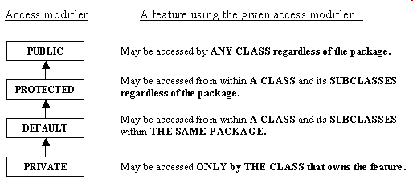
Access Modifiers
Any use, copying or distribution without written permission from UnitedHealth Group is prohibited.

Slide 29
Naming Conventions
Java is case-sensitive; maxval, maxVal, and MaxVal are three different names
Class names begin with a capital letter
All other names begin with a lowercase letter
Subsequent words are capitalized: theBigOne
Underscores are not used in names
These are very strong conventions
Any use, copying or distribution without written permission from UnitedHealth Group is prohibited.

Slide 30
Instance/Class/Local Variable
class someClass {
// Instance Variable
visibility_modifier variable_type instanceVariableName;
Private int employeeID;
// Class Variable
visibility_modifier static variable_type classVariableName;
public static int employeeCount;
// Local Variable
returnType someMethod() {
variable_type localVariableName;
double salary;
}
}
Any use, copying or distribution without written permission from UnitedHealth Group is prohibited.

Slide 31
Some of Java Keywords
  static try
  final finalise
  transient throw
  volatile throws
  this catch
  super …
  abstract
  synchronized
  super
  this
  Package
  instanceof
Any use, copying or distribution without written permission from UnitedHealth Group is prohibited.

Slide 32
The “Object” class
Parent Class of all classes in Java. It has 11 instance methods:-
hashCode()
wait()
wait(long ms)
wait(long ms,long nanoseconds)
notify()
notifyAll()
clone()
finalize()
getClass()
toString()
equals()
Any use, copying or distribution without written permission from UnitedHealth Group is prohibited.

Slide 33
Package
A Java package is a mechanism for organizing Java classes into namespaces.
A package provides a unique namespace for the types it contains.
Classes in the same package can access each other's protected members.
Packages are usually defined using a hierarchical naming pattern
    Example – java.lang.*, com.uhg.*
Classes need to be referred using its complete name (package + class name): for example, java.util.Calendar
  Packages can be “imported” to avoid writing package names every time you use * instead of class name.
  import java.util.*;
  Java.lang is implicitly imported.
Any use, copying or distribution without written permission from UnitedHealth Group is prohibited.

Slide 34
Class structure
    The package Statement
    The import Statement
    The class definition
    Example
    package com.uhg.clinical.ctb.servlet;
    import java.util.*;
    import com.uhg.clinical.ctb.domain.*;
    class ClinicalServlet {
    }
Any use, copying or distribution without written permission from UnitedHealth Group is prohibited.

Slide 35
Fundamental packages/classes
java.lang package: imported by default
java.util package: for utility collections classes & interfaces
Object class: extended by all classes by default
String/StringBuffer class: for string manipulation
Math class: for math utility functions
Thread/runnable class/interface: for multithreading
Serializable interface: for serialization
array/collection/list/set/map: for data storage
comparator/comparable: for sorting of data
Wrapper Classes: for wrapping pritive data types into objects
Any use, copying or distribution without written permission from UnitedHealth Group is prohibited.

Slide 36
OOPS
  Abstraction
  Inheritance
  Polymorphism
  Encapsulation
Any use, copying or distribution without written permission from UnitedHealth Group is prohibited.

Slide 37
Abstraction
  Abstraction is the process or result of generalization by reducing the information content of a concept or an observable phenomenon, typically in order to retain only information which is relevant for a particular purpose.
  For example, abstracting a leather soccer ball to a ball retains only the information on general ball attributes and behaviour.
  Abstraction in java is achieved through
    Interface
      Contract between class and its clients to fulfill certain responsibilities
      Cannot be instantiated
      “Implements” used and many interfaces can be implemented by a class
      Components are :
        Variables : by default public and final. No instance variables.
        Methods : by default public and abstract.
    Abstract class
      Cannot be instantiated
      Extends is used to inherit and a class can extend only one class.
      can have instance variable
      concrete methods along with/without abstract method
Any use, copying or distribution without written permission from UnitedHealth Group is prohibited.

Slide 38
Inheritance
  process by which one object acquire the property of the other object.
  ‘extends’/’implements’ keyword is used for inheritance.
  Benefits:-
    Reusability of code
    Change behavior in related way
    To add some data
  Types Of inheritance
    Multiple Inheritance
      Java supports multiple interface inheritance
    Multi Level Inheritance
      Java supports multi-level inheritance.
Any use, copying or distribution without written permission from UnitedHealth Group is prohibited.

Slide 39
Polymorphism
  a feature that allows one interface to be used for a general class of actions - having multiple forms
  is the characteristic of being able to assign a different meaning or usage to something in different contexts
  Benefits:-
    Complexity Reduction
    Better way of handling things
  Types of polymorphism
    Method Overloading compile time Polymorphism
      Method with same name and different no, types and order of parameters
    Method Overriding dynamic time Polymorphism
      Method with same name, return type and parameters in parent-child relationships
      Rule about access modifier -can have broader scope in overriding method
      Rule about exception handling -can have narrow or same scope
Any use, copying or distribution without written permission from UnitedHealth Group is prohibited.

Slide 40
Encapsulation
  Encapsulation is the ability of an object to be a container (or capsule) for related properties (ie. data variables) and methods (ie. functions).
  This ensures that variables do not have their contents changed or reused in unexpected ways.
  Data hiding is the ability of objects to shield variables from external access. It is a useful consequence of the encapsulation principle. Those variables marked as private can only be seen or modified through the use of public accessor and mutator methods. This permits validity checking at run time. Access to other variables can be allowed but with tight control on how it is done.
  Example
    Class A {
    private int x;
    public void setX(int i) { x = I; }
    public int getX() { return x; }
    }
Any use, copying or distribution without written permission from UnitedHealth Group is prohibited.

Slide 41
Exception Handling in java
Exception : What are they?
  An exception is a representation of an error condition or a situation that is not the expected result of a method.
  Exceptions, if not handled by the program will cause the program to crash.
  In Java an exception is an instance of an Exception class which is thrown by the offending code.
  Exceptions are handled by catching them and dealing with the problem.
  If not caught, exceptions are propagated from a method to the caller back through the chain of called to caller.
  If propagated out of main, they are always handled by the run time system. (virtual machine).
Any use, copying or distribution without written permission from UnitedHealth Group is prohibited.

Slide 42
Exception Handling in java
Class Hierarchy
Object
Throwable
Error
Exception
RuntimeException
...
...
...
Any use, copying or distribution without written permission from UnitedHealth Group is prohibited.

Slide 43
Exception Handling in java
Exception : How are they used?
Exceptions fall into two categories:
  Checked Exceptions
  Unchecked Exceptions
Checked exceptions are inherited from the core Java class Exception. They represent exceptions that are frequently considered “non fatal” to program execution
Checked exceptions must be handled in your code, or passed to caller method for handling.
Checked by compiler whether the exception handler for exception occurred exists or not.
Unchecked exceptions represent error conditions that are considered “fatal” to program execution.
Compiler will not force to do anything with an unchecked exception. Your program will terminate with an appropriate error message.
Any use, copying or distribution without written permission from UnitedHealth Group is prohibited.

Slide 44
Exception Handling in java
IndexOutOfBoundsException :
  When beyond the bound of index in the object which use index, such as array, string, and vector
ArrayStoreException :
  When assign object of incorrect type to element of array
NegativeArraySizeException :
  When using a negative size of array
NullPointerException :
  When refer to object as a null pointer
SecurityException :
  When violate security. Caused by security manager
Any use, copying or distribution without written permission from UnitedHealth Group is prohibited.

Slide 45
Exception Handling in java
Any number of catch methods may follow a try block.
When an exception occurs, these are scanned in order, to find a matching parameter.
If one is found, the exception is cancelled and the handler code executed.
All other catch methods are ignored.
Exceptions are instances just like other class instances and can have attributes and methods. This allows us to interrogate an exception object to find out what happened.
The exception class is a sub-class of Throwable, which provides the method printStackTrace() etc.
Having a finally block is optional and if it is there, it is always executed.
Users may create their own Exception which they can throw and handle in same way as predefined ones.
Any use, copying or distribution without written permission from UnitedHealth Group is prohibited.

Slide 46
Exception Handling in java
Exception classes fall into two groups - sub-classes of RunTimeException and others. In the case of others:
Complier will force to catch such exceptions.
This does not apply to RunTimeExceptions.
Object
Throwable
Exception
InterruptedException
IOException
RunTimeException
ParseException
IndexOutOfBoundsException
ArithmeticException
NullPointerException
ArithmeticException
Any use, copying or distribution without written permission from UnitedHealth Group is prohibited.

Slide 47
Exception Handling in java
throw Exception
An exception can be thrown by using the throw keyword.
Example
  If (accountBalance < withdrawlAmount) {
  throw insufficientFundException();
  }
throws Statement
throws clause is used in the method declaration and It signifies that the caller of the method should handle it.
When programmer-defined exception is raised / thrown and there is no exception handler, it should be declared in the throws clause of the method declaration.
Also, in case of checked exceptions, if it is not handled, it should be specified in the throws clause.
Example
  Public void addEmployee(Employee emp) throws ClinicalException { }
Any use, copying or distribution without written permission from UnitedHealth Group is prohibited.

Slide 48
Agenda
Quick revision…
Multi threading
Collection framework
String manipulations
Any use, copying or distribution without written permission from UnitedHealth Group is prohibited.

Slide 49
Multithreading in Java
Motivation
Captures logical structure of problem
  May have concurrent interacting components
  Can handle each component using separate thread
  Simplifies programming for problem
Better utilize hardware resources
  When a thread is delayed, compute other threads
  Given extra hardware, compute threads in parallel
  Reduce overall execution time
Any use, copying or distribution without written permission from UnitedHealth Group is prohibited.

Slide 50

Multithreading in Java
COUNTER
COUNTER 2
COUNTER 1
Q
Please
Serial Vs Parallel
Any use, copying or distribution without written permission from UnitedHealth Group is prohibited.

Slide 51
Multithreading in Java
A single threaded program
class ABC
{
….
  public void main(..)
  {
  …
  ..
  }
}
begin
body
end
Any use, copying or distribution without written permission from UnitedHealth Group is prohibited.

Slide 52
Multithreading in Java
Main Thread
start
start
start
Thread A
Thread B
Thread C
Threads may switch or exchange data/results
Any use, copying or distribution without written permission from UnitedHealth Group is prohibited.

Slide 53
Multithreading in Java
What are threads?
A piece of code that run in concurrence with other threads.
Each thread is a statically ordered sequence of instructions.
Threads are being extensively used on both single and multiprocessors machines.
Multithreading means programming a task having multiple threads of control.
Java has built in support for Multithreading
Java also supports synchronization when multiple threads share some common data/resource.
Thread Scheduling is done through scheduler which is part of JVM.
Inter-Thread Communication:
  currentThread start setPriority
  Run getPriority sleep
  Stop suspend resume
Java Garbage Collector is a low-priority thread.
Any use, copying or distribution without written permission from UnitedHealth Group is prohibited.

Slide 54
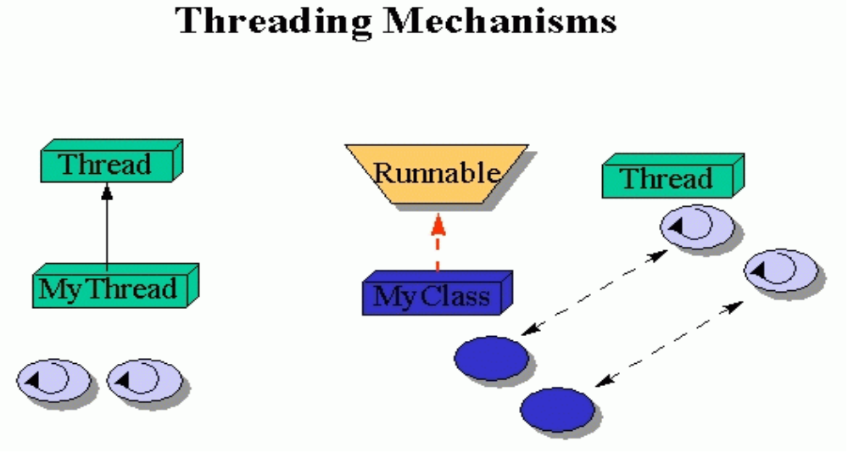
Multithreading in Java
Two approaches to create a thread
Create a class that extends Thread class and override run method.
Create a class that implements Runnable interface and implement run method.
Any use, copying or distribution without written permission from UnitedHealth Group is prohibited.

Slide 55
Multithreading in Java
Approach 1 : Extend the Thread class
Override run method of your subclass.
Create a Thread
Start execution of the thread (invoke start method)
Any use, copying or distribution without written permission from UnitedHealth Group is prohibited.

Slide 56
Multithreading in Java
Approach 2 : implement the Runnable interface
Override run method of your class.
Create object of the class implementing Runnable
Create a Thread object passing the runnable object in constructor.
Start execution of the thread by invoking the start method.
Any use, copying or distribution without written permission from UnitedHealth Group is prohibited.

Slide 57
Multithreading in Java
Thread state
Java thread can be in one of these states
  New – thread allocated & waiting for start()
  Runnable – thread can begin execution
  Running – thread currently executing
  Blocked – thread waiting for event (I/O, etc.)
  Dead – thread finished
Transitions between states caused by
  Invoking methods in class Thread
    new(), start(), sleep(), wait(), notify()…
  Other (external) events
    Scheduler, I/O, returning from run()…
Any use, copying or distribution without written permission from UnitedHealth Group is prohibited.

Slide 58
Multithreading in Java
State diagram
new
start
new
runnable
notify, notifyAll,
IO complete, sleep expired,
join complete
yield,
time slice
scheduler
running
blocked
IO, sleep,
wait, join
terminate
dead
Any use, copying or distribution without written permission from UnitedHealth Group is prohibited.

Slide 59
Multithreading in Java
  Start() method spawns a new thread and the new thread is executed in the tun method of the thread class / runnable interface.
  Run method is oerriden by the class extending the thread class/ implementing the runnable interface to define the activities to be performed by the new thread.
  Sleep() method Causes the currently executing thread to sleep (temporarily cease execution) for the specified number of milliseconds.
  setPriority() method Changes the priority of this thread.
  Join() method Waits for this thread to die.
  setDaemon() is used to mark the thread as daemon.
Any use, copying or distribution without written permission from UnitedHealth Group is prohibited.

Slide 60
Multithreading in Java
Java threads types
  User
  Daemon
    Provide general services
    Typically never terminate
    Call setDaemon() before start()
Thread death
  Completion of run method.
  Stop, destroy (deprecated).
Scheduler
  Determines which runnable threads to run
  Can be based on thread priority
  Part of OS or Java Virtual Machine (JVM)
Any use, copying or distribution without written permission from UnitedHealth Group is prohibited.

Slide 61
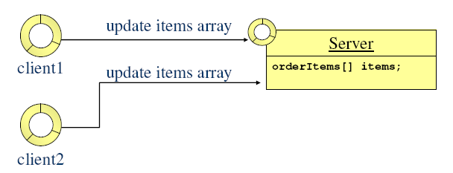
Multithreading in Java
Thread safe Programming
In some situations threads depend on each other:
  one thread should wait until another is done.
  threads share a data structure / resource.
Thread safe programming is necessary when data can be modified by more than one thread at a time.
If multiple clients can change shared server data, a thread-safe design is needed.
Any use, copying or distribution without written permission from UnitedHealth Group is prohibited.

Slide 62
Multithreading in Java
Synchronization
In Java, every class and every instance of a class has a lock associated with it.
The synchronized keyword identifies places where a thread must acquire the lock before proceeding.
    Class A {
    static synchronized void validate() {}
    static synchronized void restore() {}
    synchronized void update() {}
    }
Any use, copying or distribution without written permission from UnitedHealth Group is prohibited.

Slide 63
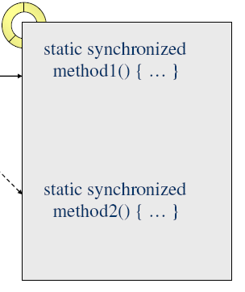
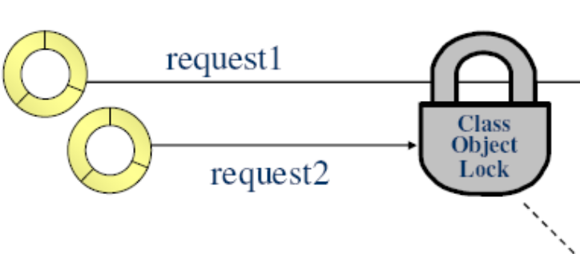
Multithreading in Java
Synchronization : class lock
All static synchronized methods in a class use the same class lock.
Request2 is blocked until request1 returns from synchronized
static method1.
Any use, copying or distribution without written permission from UnitedHealth Group is prohibited.

Slide 64
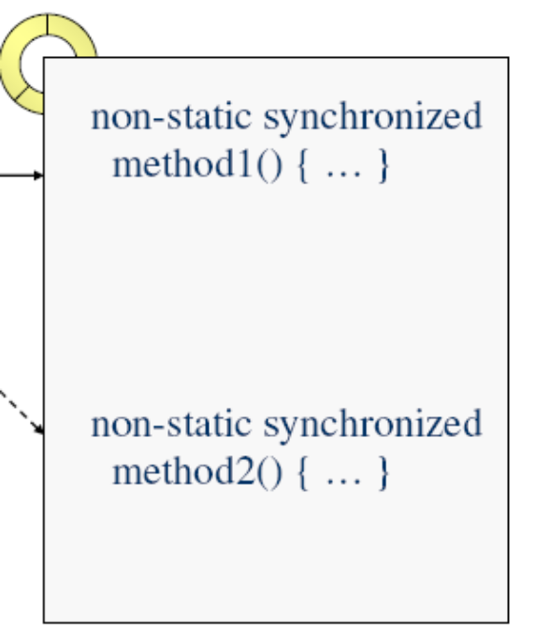
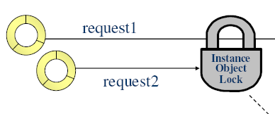
Multithreading in Java
Synchronization : object lock
For each object of a class, all synchronized instance methods use the same instance object lock.
Request2 is blocked until request1 returns from synchronized instance method1.
Any use, copying or distribution without written permission from UnitedHealth Group is prohibited.

Slide 65
Multithreading in Java
Communication
The Object class wait() and notify() methods enable a thread to give up its lock and to wait for another thread to give it back before proceeding.
Class A {
synchronized void update() {
1.Obtain Lock // do some stuff
2.Give up Lock wait();
// do some stuff 5.Reacquire Lock
}
synchronized void replace() {
3.Obtain Lock // do some stuff
notify(); 4.wake up sleeping threads
// do more things
}
}
Any use, copying or distribution without written permission from UnitedHealth Group is prohibited.

Slide 66
Multithreading in Java
Synchronized access to ArrayList elements
Class Producer {
synchronized void putMessage() {
// do some stuff
while(noRoomForMessage) {
wait(); // give up lock
} // re-acquire lock
messages.add(msg1);
notify();
}
synchronized void getMessage() {
// do some stuff
while(noMessage){
wait(); // give up lock
} // re-acquire lock
messages.remove(msg1);
notify();
// do more things
}
Any use, copying or distribution without written permission from UnitedHealth Group is prohibited.

Slide 67
Collection Framework
A collection — sometimes called a container — is simply an object that groups multiple elements into a single unit. Collections are used to store, retrieve, manipulate, and communicate aggregate data. Typically, they represent data items that form a natural group, such as a poker hand (a collection of cards), a mail folder (a collection of letters), or a telephone directory (a mapping of names to phone numbers).
A collections framework is a unified architecture for representing and manipulating collections. All collections frameworks contain the following:
  Interfaces: These are abstract data types that represent collections. Interfaces allow collections to be manipulated independently of the details of their representation. In object-oriented languages, interfaces generally form a hierarchy.
  Implementations: These are the concrete implementations of the collection interfaces. In essence, they are reusable data structures.
  Algorithms: These are the methods that perform useful computations, such as searching and sorting, on objects that implement collection interfaces. The algorithms are said to be polymorphic: that is, the same method can be used on many different implementations of the appropriate collection interface. In essence, algorithms are reusable functionality.
Any use, copying or distribution without written permission from UnitedHealth Group is prohibited.

Slide 68
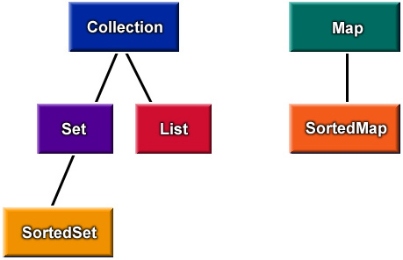
Collection Framework
Interfaces
Group of
Objects
Dictionary
(key->value)
Unordered,
no duplicates
OrderedCollection
Sorted Dictionary
SortedCollection
Any use, copying or distribution without written permission from UnitedHealth Group is prohibited.

Slide 69
Collection Framework
Collection interface
add(o) Add a new element
addAll(c) Add a collection
clear() Remove all elements
contains(o) Membership checking.
containsAll(c) Inclusion checking
isEmpty() Whether it is empty
iterator() Return an iterator
remove(o) Remove an element
removeAll(c) Remove a collection
retainAll(c) Keep the elements
size() The number of elements
Any use, copying or distribution without written permission from UnitedHealth Group is prohibited.

Slide 70
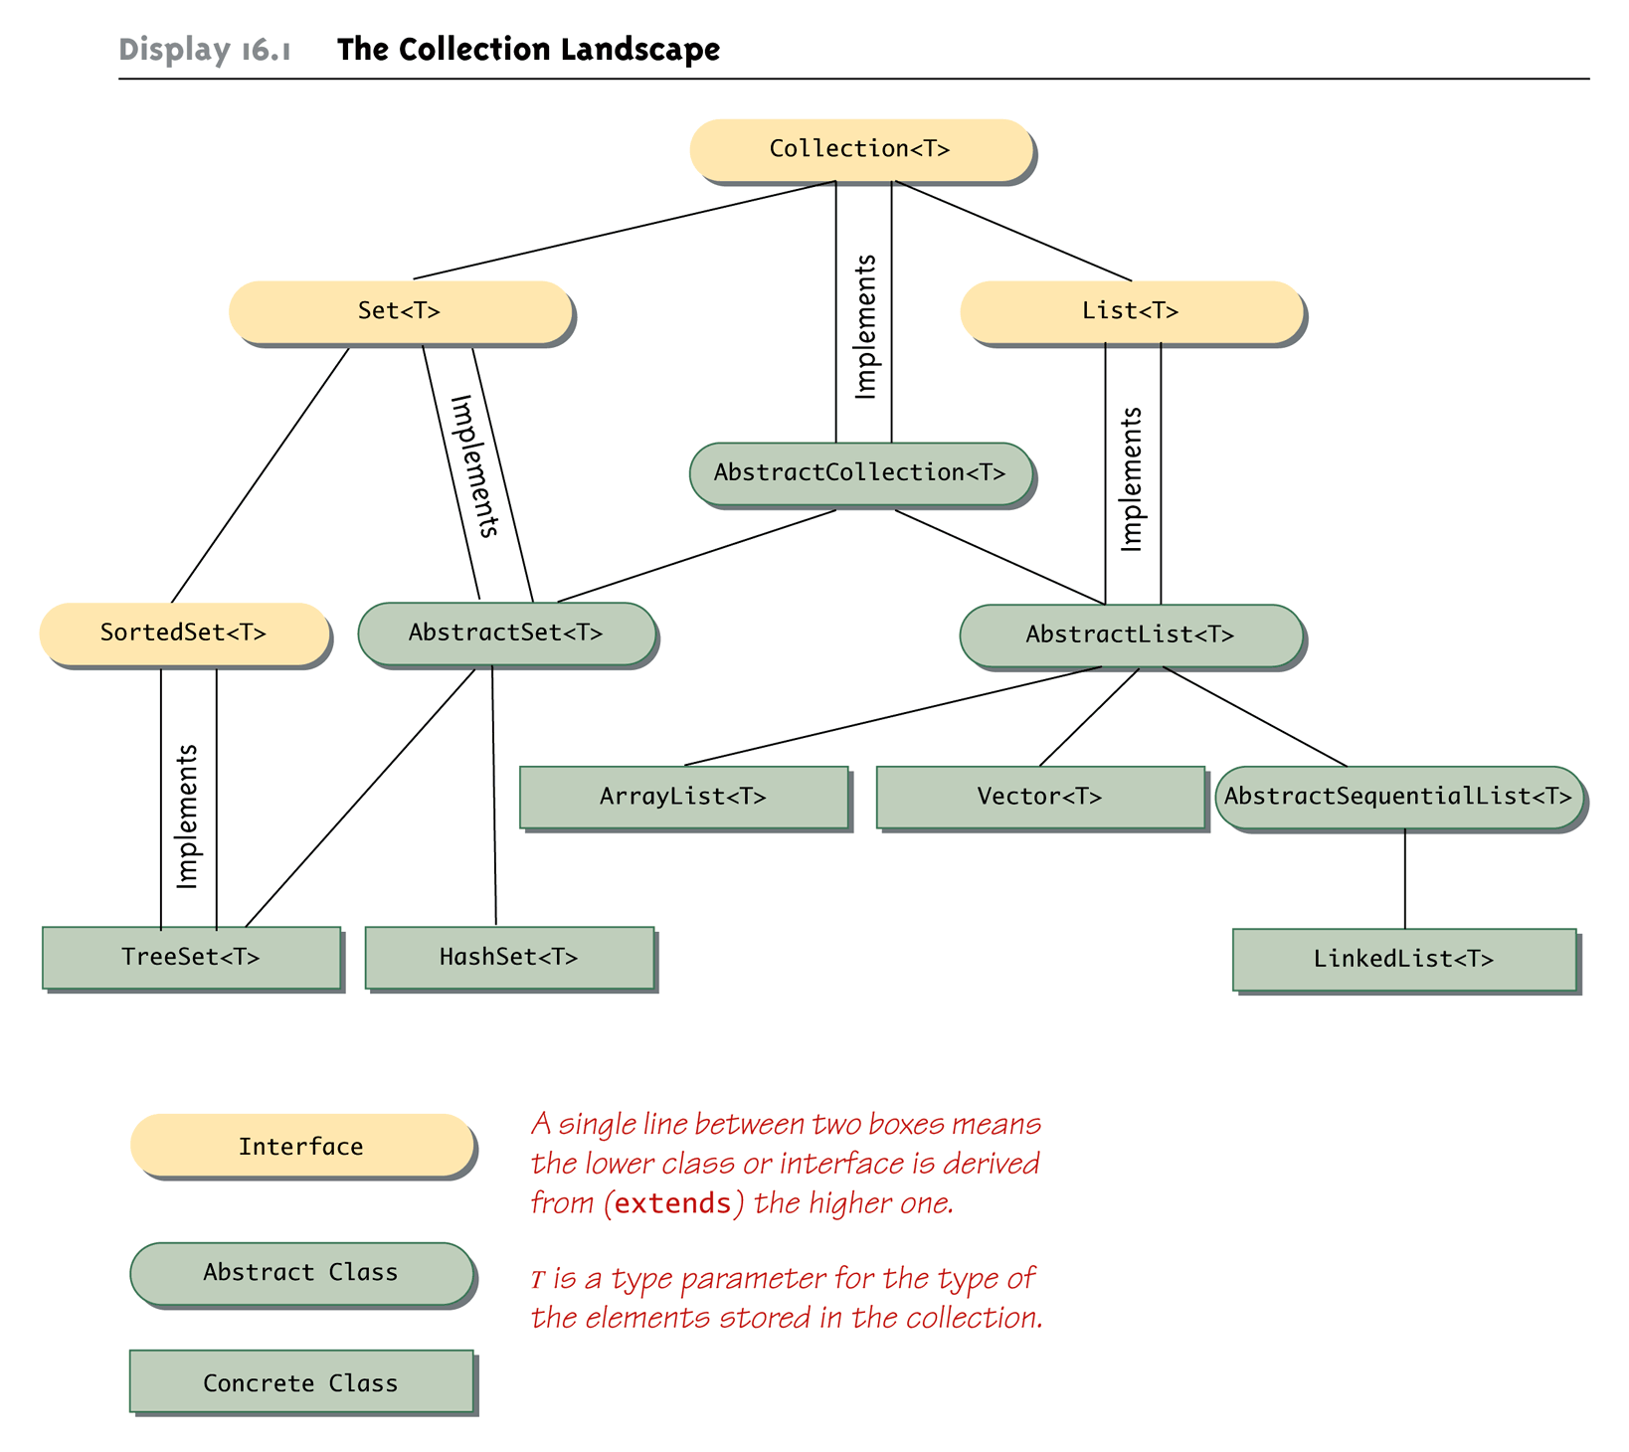
Collection Framework
Hierarhy
Any use, copying or distribution without written permission from UnitedHealth Group is prohibited.

Slide 71
Collection Framework
  List
    a collection of elements (numbers, strings, accounts, pictures,…)
    ordered (a sequence): there is a first, and a last element
      lists can be empty – no elements
    also known as a sequence
    ArrayList
      stores a collection of any type of object
      can be all the same type, or different types
      similar functionality to an array, but does not use subscripts
      is an indexed collection
    Vector
      Is a synchronized list.
Any use, copying or distribution without written permission from UnitedHealth Group is prohibited.

Slide 72
Collection Framework
List interface
add(i,o) Insert o at position i
add(o) Append o to the end
get(i) Return the i-th element
remove(i) Remove the i-th element
set(i,o) Replace the i-th element with o
indexOf(o)
lastIndexOf(o)
listIterator()
sublist(i,j)
Any use, copying or distribution without written permission from UnitedHealth Group is prohibited.

Slide 73
Collection Framework
Iterators
The iterator() method of the Collection interface returns an Iterator.
Iterators provide a general way to traverse all elements in a collection.
Also, the Iterators allow the caller to remove elements from the underlying
collection during the iteration with well-defined semantics.
Public boolean hasNext()
Public Object next()
Public void remove
Any use, copying or distribution without written permission from UnitedHealth Group is prohibited.

Slide 74
Collection Framework
Generics
A List can be made to store only one type
List<BankAccount> accountList = new ArrayList<BankAccount>();
accountList.add(new BankAccount("One", 111.11));
accountList.add(new BankAccount("Two", 222.22));
accountList.add(new BankAccount("Three", 333.33));
accountList.add(new BankAccount("Four", 444.44));
System.out.println(accountList.toString());
Any use, copying or distribution without written permission from UnitedHealth Group is prohibited.

Slide 75
Collection Framework
Set
A collection that contains no duplicate elements. More formally, sets contain no pair of elements e1 and e2 such that e1.equals(e2), and at most one null element. As implied by its name, this interface models the mathematical set abstraction.
add(o)
addAll(Collection c)
Contains(o)
remove(o) Remove the i-th element
removeAll(Collection c)
indexOf(o)
iterator()
Size()
Any use, copying or distribution without written permission from UnitedHealth Group is prohibited.

Slide 76
Collection Framework
HashSet
This class implements the Set interface. It makes no guarantees as to the iteration order of the set; in particular, it does not guarantee that the order will remain constant over time. This class permits the null element.
Hashset is not a synchronized collection
Any use, copying or distribution without written permission from UnitedHealth Group is prohibited.

Slide 77
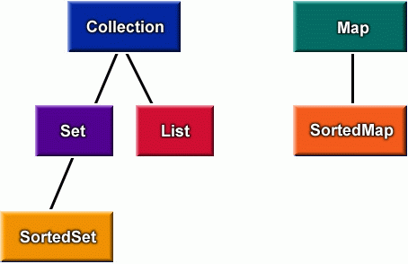
Collection Framework
Map
Unlike List and Set, Map does not implement Collection interface.
It is a key value pair collection. The interface describes a mapping from keys to values, without duplicate keys, by defination . The order of a map is defined as the order in which the iterators on the map's collection views return their elements. Some map implementations, like the TreeMap class, make specific guarantees as to their order; others, like the HashMap class, do not.
put(k,v)
get(k)
remove(k)
containsKey(k)
containsValue(v)
keySet()
values()
size()
clear()
Any use, copying or distribution without written permission from UnitedHealth Group is prohibited.

Slide 78
Collection Framework
HashMap
HashMap is implementation of map interface. The implementation provides all of the optional map operations, and permits null values and the null key. (The HashMap class is roughly equivalent to Hashtable, except that it is unsynchronized and permits nulls.)
This class makes no guarantees as to the order of the map; in particular, it does not guarantee that the order will remain constant over time.
This implementation provides constant-time performance for the basic operations (get and put), assuming the hash function disperses the elements properly among the buckets.
The implementation is not synchronized.
Any use, copying or distribution without written permission from UnitedHealth Group is prohibited.

Slide 79
Collection Framework
Collections Class
It is a utility class which has methods for sorting, synchronizing, copying etc.
This class consists exclusively of static methods that operate on or return collections. It contains polymorphic algorithms that operate on collections, "wrappers", which return a new collection backed by a specified collection, and a few other odds and ends.
Sorting
Collections.sort(List l);
Collections.sort(List l, Comparator c);
There are two conditions on which a collection can be sorted. Either of the one should be satisfied :
  The collection contains object of type Comparable interface.
  Pass a Comparator for sorting
  Note : All the wrapper classes implements Comparable.
Any use, copying or distribution without written permission from UnitedHealth Group is prohibited.

Slide 80
Collection Framework
Insert an object of type string in HashSet. Sort the collection and retreive the elements in the set using Iterator.
Create 5 employee objects. Insert empid as key and the objects as values in a HashMap instance. Iterate using Iterator.
Any use, copying or distribution without written permission from UnitedHealth Group is prohibited.

Slide 81
Thanks
Any use, copying or distribution without written permission from UnitedHealth Group is prohibited.

Slide 82
Questions
Any use, copying or distribution without written permission from UnitedHealth Group is prohibited.

